Slide 1
Financial Fundamentals

Slide 2
Financing and the corporation
Taxes
Government
Workers
Labor
Corporation
Cash Flow
Wages
Capital
Reinvestment
Investors
Cash flow to investors
Financing

Slide 3
Corporate securities
Generally break investors into two categories: equity & debt
Equity: receive dividends
Common equity: control rights, dividends not mandatory (“residual claimants”)
Preferred equity: contingent control rights, dividends mandatory but can be accrued
Debt: receive interest, non-payment of interest triggers default, control rights in bankruptcy
Bank loans and other private debt contracts
Bonds (securities)
Debt
Preferred equity
Common equity
Less flexible
More flexible

Slide 4
Important features of debt
Interest rate (%, fixed vs. floating, reference rate)
Seniority (senior, subordinated, etc.): lender’s “priority” in the event of bankruptcy ← will discuss more later in these slides
Conversion & callability features ← may discuss more when we talk about importance of information in security issuance decisions
Repayment terms/maturity: when principal and interest are to be paid
Collateral: lender’s “security interest” in borrower’s assets
Covenants: restrict/mandate borrower actions & conditions

Slide 5
Interest rate
Interest owed = interest rate x principal balance
Fixed interest rate: Preset percentage (e.g., 7%)
Floating (aka variable) interest rate: Percentage that varies over time with a specified reference rate (e.g., LIBOR + 2%)
Common indices:
LIBOR: London Interbank Offer Rate; most commonly used reference rate; will cease to exist in 2021
SOFR: Secured overnight reference rate; likeliest replacement for LIBOR as most common reference rate
Prime rate: Generally federal funds rate + 3%; used by banks

Slide 6
Repayment terms/maturity
Term (amortizing) loan: Fixed periodic payment of interest + principal (e.g., residential mortgage)
Interest-only loan: Fixed period payment of interest only; principal due at maturity
Balloon payment: Principal repayment still due at maturity
Revolver (AKA line of credit): Can draw down & repay repeatedly (like a credit card); generally short maturity (e.g., 1 yr), typically renewed
Often used by companies to finance working capital needs
Commercial paper: Very short-term debt; publicly-traded; typically rolled over
Pre-payment penalty: Borrower pays penalty if loan repaid before maturity

Slide 7
Collateral
“Security interest”: Creditor can claim in event of firm liquidation ← will discuss more when we talk about bankruptcy
Can borrow more against more liquid collateral (often 100% against cash)
Banks often lend up to a fixed percentage of collateral value, depending on collateral type
E.G., 80% of real estate value, 50% of equipment value, 75% of accounts receivable value
Less specialized assets tend to be better collateral b/c they are more liquid (easier to dispose of by selling)
Less specialized assets: Oil wells, apartment buildings, land
More specialized assets: Customized equipment, patents

Slide 8
Covenants
Affirmative (AKA positive) covenants: Require company to take certain actions
Examples: Issuer required to provide lender with monthly financial statements; Issuer required to maintain insurance on collateral; Issuer required to maintain tangible net worth > $X
Restrictive (AKA negative) covenants: Preclude company from taking certain actions
Examples: Issuer cannot issue additional debt w/o permission of lender; Issuer cannot pay dividends w/o permission of lender; Issuer cannot sell assets used as collateral
Violation of covenant → “technical default”
Lenders often waive technical defaults in exchange for compensation (e.g., higher interest rate, one-time fee)
Why would a company agree to loan terms that limit its flexibility?

Slide 9
Equity and limited liability
If you own equity in a corporation, what is the most that you can lose?
Limited liability: Cannot lose more than the amount you have invested
Why would limited liability be a desirable feature for an economy?
Need people to take risks. Risk-averse people may be unwilling to take risks if they face the risk of unlimited losses
Principals of small companies often asked to guarantee loans; circumvents limited liability

Slide 10
Internal and external financing
External financing:
Issuing new common/preferred stock (equity)
Issuing bonds or borrowing from a bank (debt)
Internal financing:
Retained earnings (equity)

Slide 11
Capital structure
Mix of securities used to finance a company’s operations
Simple level: What is the mix of equity and debt?
Financial leverage: Relative amount of debt in the capital structure

Slide 12
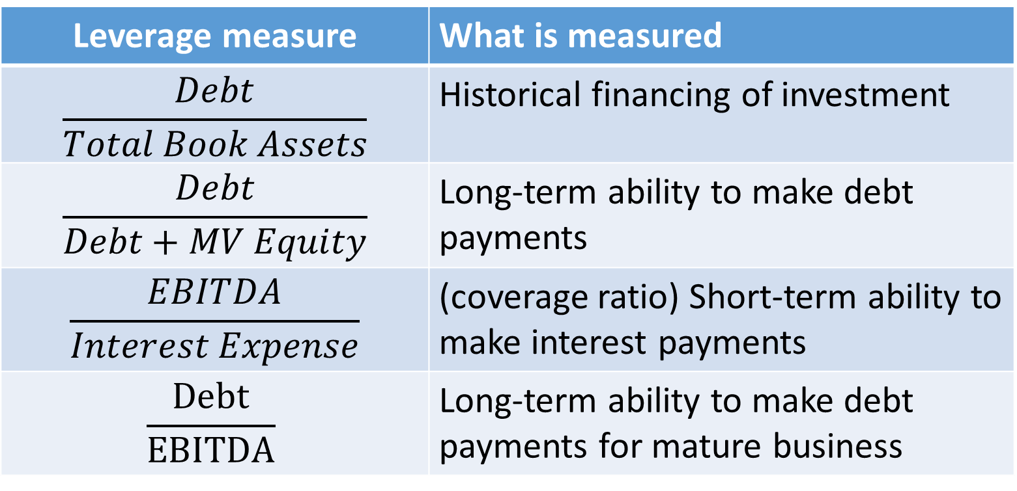
Financial leverage measures
Leverage measure | What is measured
$$\frac{Debt}{Total Book Assets}$$ | Historical financing of investment
$$\frac{Debt}{Debt+MV Equity}$$ | Long-term ability to make debt payments
$$\frac{EBITDA}{Interest Expense}$$ | (coverage ratio) Short-term ability to make interest payments
$$\frac{Debt}{EBITDA}$$ | Long-term ability to make debt payments for mature business

Slide 13
Leverage ratios by industry
Industry | Debt/(Debt + MV Equity)
Energy | 43.2%
Paper & plastic | 30.4%
Food production | 22.9%
Retail | 21.7%
Business equipment | 19.1%
Chemicals | 17.3%
Computer software | 3.5%
Overall average | 21.5%

Slide 14
Financial alchemy?
 | Equity | Debt
Cost of capital | 20% | 8%
Original amount | $2.0B | $0.0B
New amount | $1.4B | $0.6B
Saved company $0.6B x (20% - 8%) = $72M per year?
Ignores increase in cost of equity (the “leverage effect”)

Slide 15
Debt and the leverage effect
 | Expansion | Recession
Cash Flow | $100M | $50M
Invest $60M today
 | All equity | Half debt
Invest (equity) | $60M | $30M
Borrow (debt) @ 10% | $0M | $30M
Repay lender | $0M | $33M
CF → Equity (ROE)
Expansion | $100M (+67%) | $67M (+123%)
Recession | $50M (-17%) | $17M (-43%)

Slide 16
Leverage and value
No financial alchemy → Leverage does not directly change WACC
Company Value $=\frac{E[{CF}_{1}]}{{(1+WACC)}^{1}}+\frac{{E[CF}_{2}]}{{(1+WACC)}^{2}}+\frac{{E[CF}_{3}]}{{(1+WACC)}^{3}}+…$
For capital structure to matter (affect company value), what must be true?
Capital structure only matters (affects company value) if it somehow affects expected cash flows.

Slide 17
Modigliani and Miller Proposition
If
If a firm’s financial structure does not affect the sum of all future cash flows to a firm’s financial claimants (i.e., the cash flow that the firm’s assets generate)
A firm cannot issue “unique” securities (a technical condition)
Then
The total market value of the firm is independent of how it is financed (i.e., capital structure is irrelevant)

Slide 18
Pie analogy
Think of the firm’s total cash flows as a pie
Capital structure = how we slice up the pie between shareholders and creditors
M&M: How we slice up the pie only matters if affects the size of the pie
Debt
Equity

Slide 19
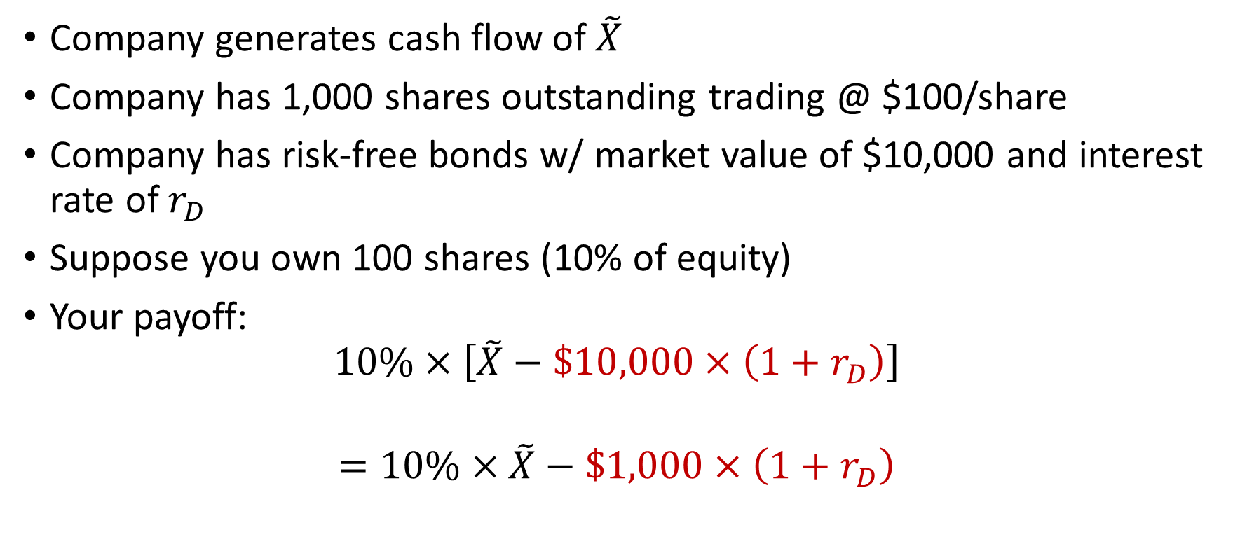
Homemade leverage argument
Company generates cash flow of $\tilde{X}$
Company has 1,000 shares outstanding trading @ $100/share
Company has risk-free bonds w/ market value of $10,000 and interest rate of $r_{D}$
Suppose you own 100 shares (10% of equity)
Your payoff:
$$10\%×\left[\tilde{X}−\$10,000×\left(1+r_{D}\right)\right]$$
$$=10\%×\tilde{X}−\$1,000×\left(1+r_{D}\right)$$
Your share of company’s total cash flows
Your share of company’s debt

Slide 20
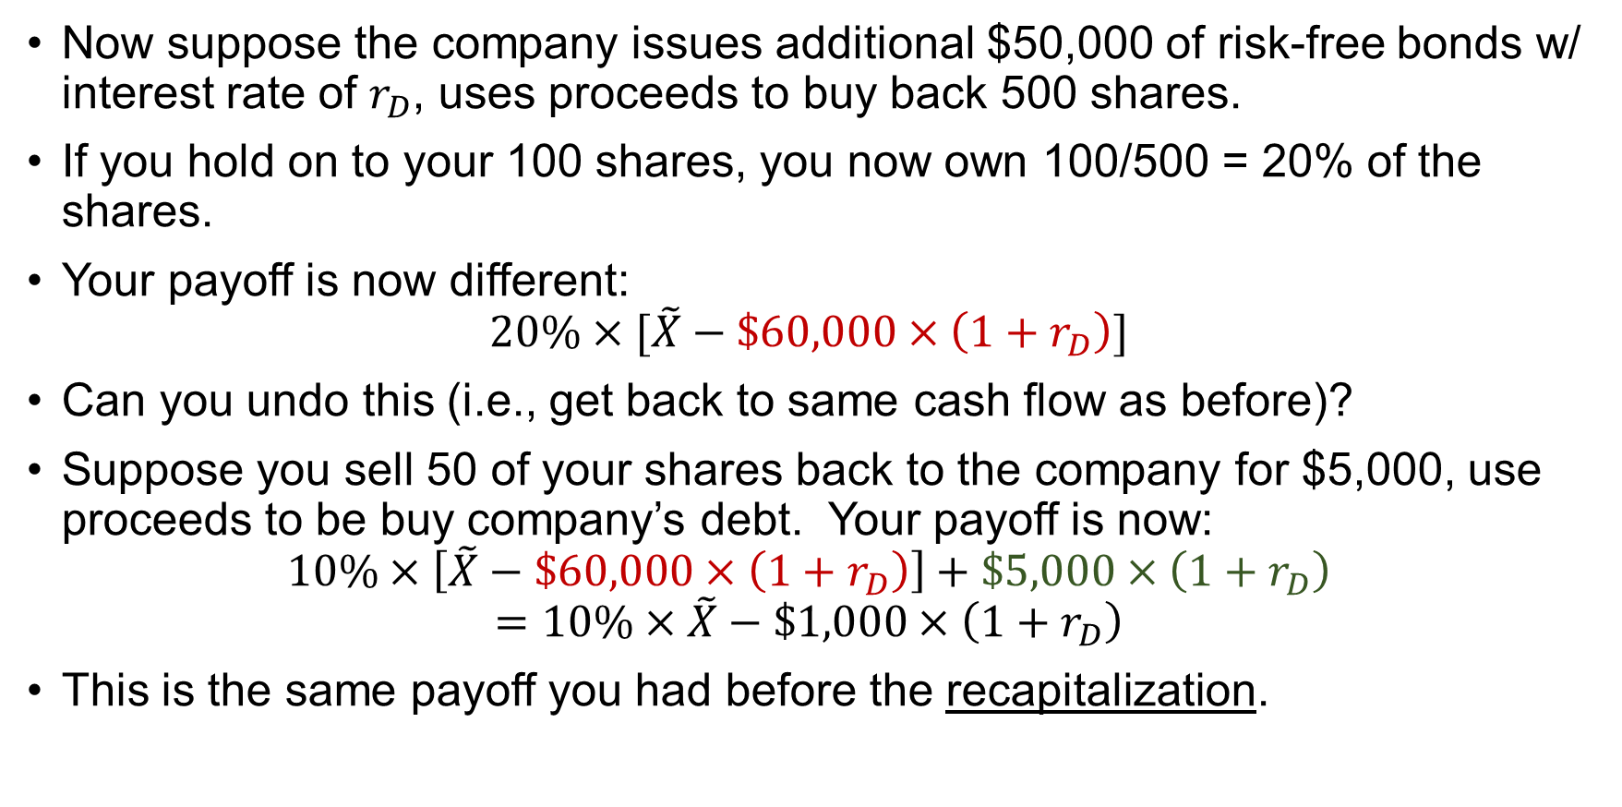
Homemade leverage argument
Now suppose the company issues additional $50,000 of risk-free bonds w/ interest rate of $r_{D}$, uses proceeds to buy back 500 shares.
If you hold on to your 100 shares, you now own 100/500 = 20% of the shares.
Your payoff is now different:
$$20\%×[\tilde{X}−\$60,000×\left(1+r_{D}\right)]$$
Can you undo this (i.e., get back to same cash flow as before)?
Suppose you sell 50 of your shares back to the company for $5,000, use proceeds to be buy company’s debt. Your payoff is now:
$$10\%×\left[\tilde{X}−\$60,000×\left(1+r_{D}\right)\right]+\$5,000×\left(1+r_{D}\right)$$
$$=10\%×\tilde{X}−\$1,000×\left(1+r_{D}\right)$$
This is the same payoff you had before the recapitalization.

Slide 21
Homemade leverage argument
You can undo the company’s financial restructuring.
Argument works in reverse: Can undo effect of equity issuance and debt repayment by buying equity and short-selling debt.
Company cannot be creating (or destroying) value just by doing something that you as an investor can do on your own.

Slide 22
No-arbitrage argument
Consider firms U and L that have identical cash flows next year (and no cash flows after next year)
Firm U is all equity financed, has 10M shares trading at $15 per share, for total value of $150M
Firm L has risk-free debt of $60M with interest rate of 10%, with principal and interest due next year
Claim: Value of firm L’s equity must by $90M
 | Recession | Normal | Expansion
Probability | 1/3 | 1/3 | 1/3
Cash flow | $80M | $180M | $280M

Slide 23
Arbitrage
True arbitrage: Either
Make $ today w/ zero future cash flow exposure
Make guaranteed positive future cash flow in at least one future period, w/ guarantee of no losses in any future period, at no cost today
True arbitrage opportunities in the market should disappear almost immediately
Does not imply that market is fully efficient – can still be risky mispriced financial assets that earn positive NPV

Slide 24
Short-selling
Shorting (AKA short-selling) a company’s stock:
Today:
Borrow a share of stock from a shareholder of the company (usually at a very low interest rate)
Sell the share of stock to a buyer for cash
Invest the cash and earn a return
Sometime in the future:
Buy a share of the stock (probably on an exchange)
Return the new share to the lender of the original share (one share is as good as another)
Some assets can only be effectively shorted indirectly (e.g., John Paulson betting against U.S. housing prices in 2007 using credit default swaps)

Slide 25
No-arbitrage argument
Payoffs to shareholders of Firm U (recall that this firm has no debt)
Payoffs to shareholders and creditors of firm L
 | Recession | Normal | Expansion
Shareholders | $80M | $180M | $280M
 | Recession | Normal | Expansion
Total CF | $80M | $180M | $280M
Creditors | $66M | $66M | $66M
Shareholders | $14M | $114M | $214M

Slide 26
No-arbitrage example
Payoff to owning 10% of firm U
Payoffs to owning 10% of firm L’s equity and 10% of firm L’s debt
Payoffs identical, so value must be the same:
10% x $150M = 10% x E_{L} + 10% x $60M => E_{L} = $90M
Value of U ($150M equity) = Value of L ($60M debt + $90M equity)
Recession | Normal | Expansion
$8M | $18M | $28M
 | Recession | Normal | Expansion
Equity | $1.4M | $11.4M | $21.4M
Debt | $6.6M | $6.6M | $6.6M
Shareholders | $8M | $18M | $28M

Slide 27
No-arbitrage example
Recall that value of Firm U’s equity is $150M, Firm L has $60M of debt
Suppose market value of Firm L’s equity is less than $90M
Buy 10% of L’s debt for $6M, 10% of L’s equity for less than $9M, so total outflow is less than $15M
Short-sell 10% of U’s equity for inflow of $15M
No future cash flow exposure, so difference is arbitrage profit
Suppose market value of Firm L’s equity is greater than $90M
Buy 10% of U’s equity for outflow of $15M
Short-sell 10% of L’s debt for $6M, 10% of L’s equity for more than $9M, so total inflow of more than $15M
No future cash flow exposure, so difference is arbitrage profit
Market forces should immediately push market value of L’s equity to $90M

Slide 28
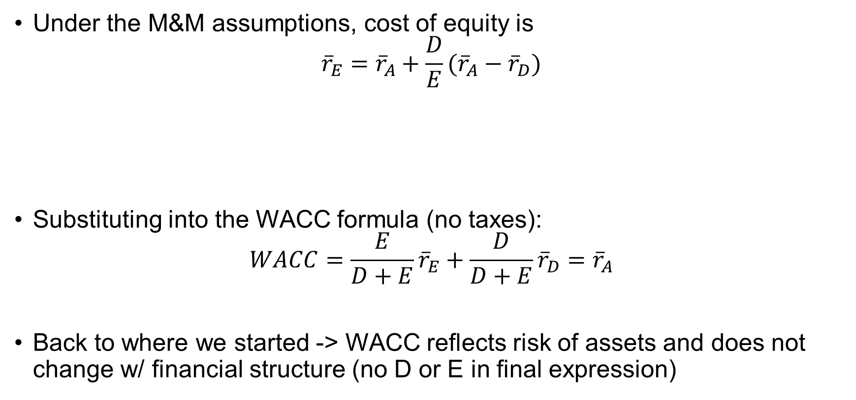
Debt and the cost of equity
Under the M&M assumptions, cost of equity is
$${\overline{r}}_{E}={\overline{r}}_{A}+\frac{D}{E}({\overline{r}}_{A}−{\overline{r}}_{D})$$
Substituting into the WACC formula (no taxes):
$$WACC=\frac{E}{D+E}{\overline{r}}_{E}+\frac{D}{D+E}{\overline{r}}_{D}={\overline{r}}_{A}$$
Back to where we started -> WACC reflects risk of assets and does not change w/ financial structure (no D or E in final expression)
Premium for business risk
Additional premium for financial risk

Slide 29
Debt and the cost of equity
Continuing w/ example, rate of return to owners of U’s $150M of equity:
Expected return = (1/3)(-46.7%)+(1/3)(20.0%)+(1/3)(86.7%) = 20.0%
Rate of return to owners of L’s $90M of equity:
Expected return = (1/3)(-84.4%)+(1/3)(26.7%)+(1/3)(137.8%) = 26.7%
 | Recession | Normal | Expansion
Cash flow | $80M | $180M | $280M
ROE | -46.7% | 20.0% | 86.7%
 | Recession | Normal | Expansion
Cash flow | $14M | $114M | $214M
ROE | -84.4% | 26.7% | 137.8%

Slide 30
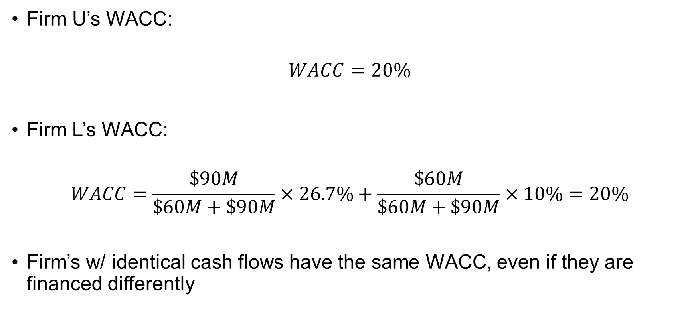
Debt and cost of equity
Firm U’s WACC:
$$WACC=20\%$$
Firm L’s WACC:
$$WACC=\frac{\$90M}{\$60M+\$90M}×26.7\%+\frac{\$60M}{\$60M+\$90M}×10\%=20\%$$
Firm’s w/ identical cash flows have the same WACC, even if they are financed differently

Slide 31
The leverage effect (one last time)
Senior partner in a private equity firm: “We use leverage to provide our investors with a more attractive return”
Does higher leverage imply higher expected return on equity?
Yes, leverage effect
Does higher leverage create value by increasing expected return on equity?
No, higher leverage -> greater risk, higher expected return just compensation for higher risk
Homemade leverage argument: Anyone can borrow and invest in equity on their own; don’t need private equity firm to do it for us

Slide 32

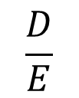



Debt and cost of equity & debt
$${\overline{r}}_{E}$$
$${\overline{r}}_{A}$$
$${\overline{r}}_{D}$$
$$r_{F}$$
Risk-free debt
Risky debt
$$\frac{D}{E}$$

Slide 33
Modigliani and Miller takeaways
No financial alchemy
Need to focus on why leverage changes total cash flows (to all financial claimants)
Why might leverage change total cash flows?

Slide 34
Debt and corporate taxes
 | All equity | Some debt
Earnings before interest & taxes (EBIT) | $100M | $100M
Interest payments | - 0M | - 40M
Earnings before taxes | 100M | 60M
Corporate taxes (@ 40%) | - 40M | - 24M
Net income | 60M | 36M
Shareholders receive | $60M | $36M
Creditors receive | 0M | 40M
Total cash flow to all investors | 60M | 76M

Slide 35
Debt and taxes
When we use WACC in practice, we adjust for debt tax shields in discount rate, not in expected cash flows
Adjust for tax shields in discount rate for convenience, but should really think about tax shields as part of expected cash flow (as we do w/ APV)
Higher debt reduces government’s “share” of firm’s case flows:
Taxes
Taxes
Debt
Debt
Equity
Equity

Slide 36
Features of U.S. corporate tax code
Territorial tax system: Income earned in U.S. taxable
Before 2018: Worldwide taxation; foreign income only taxed when repatriated (credit for foreign taxes paid)
Corporate tax rate: 21%
Before 2018: Graduated percentage, top rate of 35%
Tax loss carryforwards
Can carry tax losses (AKA NOLs) forward unlimited time (carrybacks no longer allowed)
Deductions limited to 80% of taxable income
Section 392 limitations in event of change in control
“Classical” tax system: Interest payments tax deductible, payments to shareholders (dividends & share repurchases) not
Deduction limited to 30% of EBITDA in 2018, 30% of EBIT in later years
Imputation system (Australia, New Zealand, many countries in Europe pre-2000s): Dividends accompanied by “franking” credit for corporate taxes paid

Slide 37
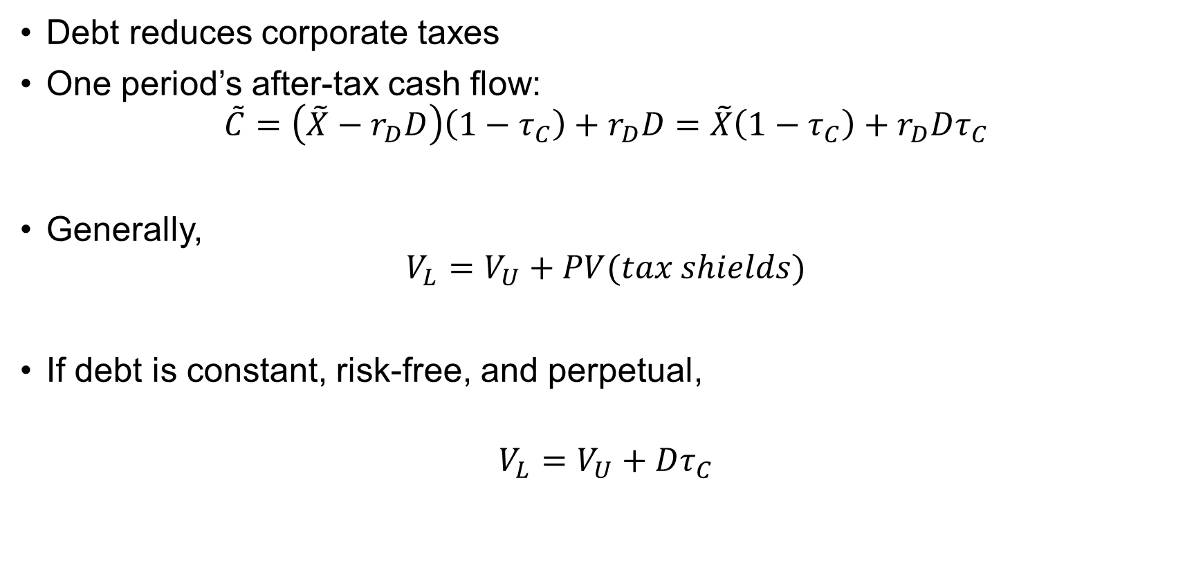
Value of debt tax shields
Debt reduces corporate taxes
One period’s after-tax cash flow:
$$\tilde{C}=\left(\tilde{X}−r_{D}D\right)\left(1−τ_{C}\right)+r_{D}D=\tilde{X}\left(1−τ_{C}\right)+r_{D}Dτ_{C}$$
Generally,
$$V_{L}=V_{U}+PV(tax shields)$$
If debt is constant, risk-free, and perpetual,
$$V_{L}=V_{U}+Dτ_{C}$$
Cash flow if all equity financed
Tax
shields

Slide 38
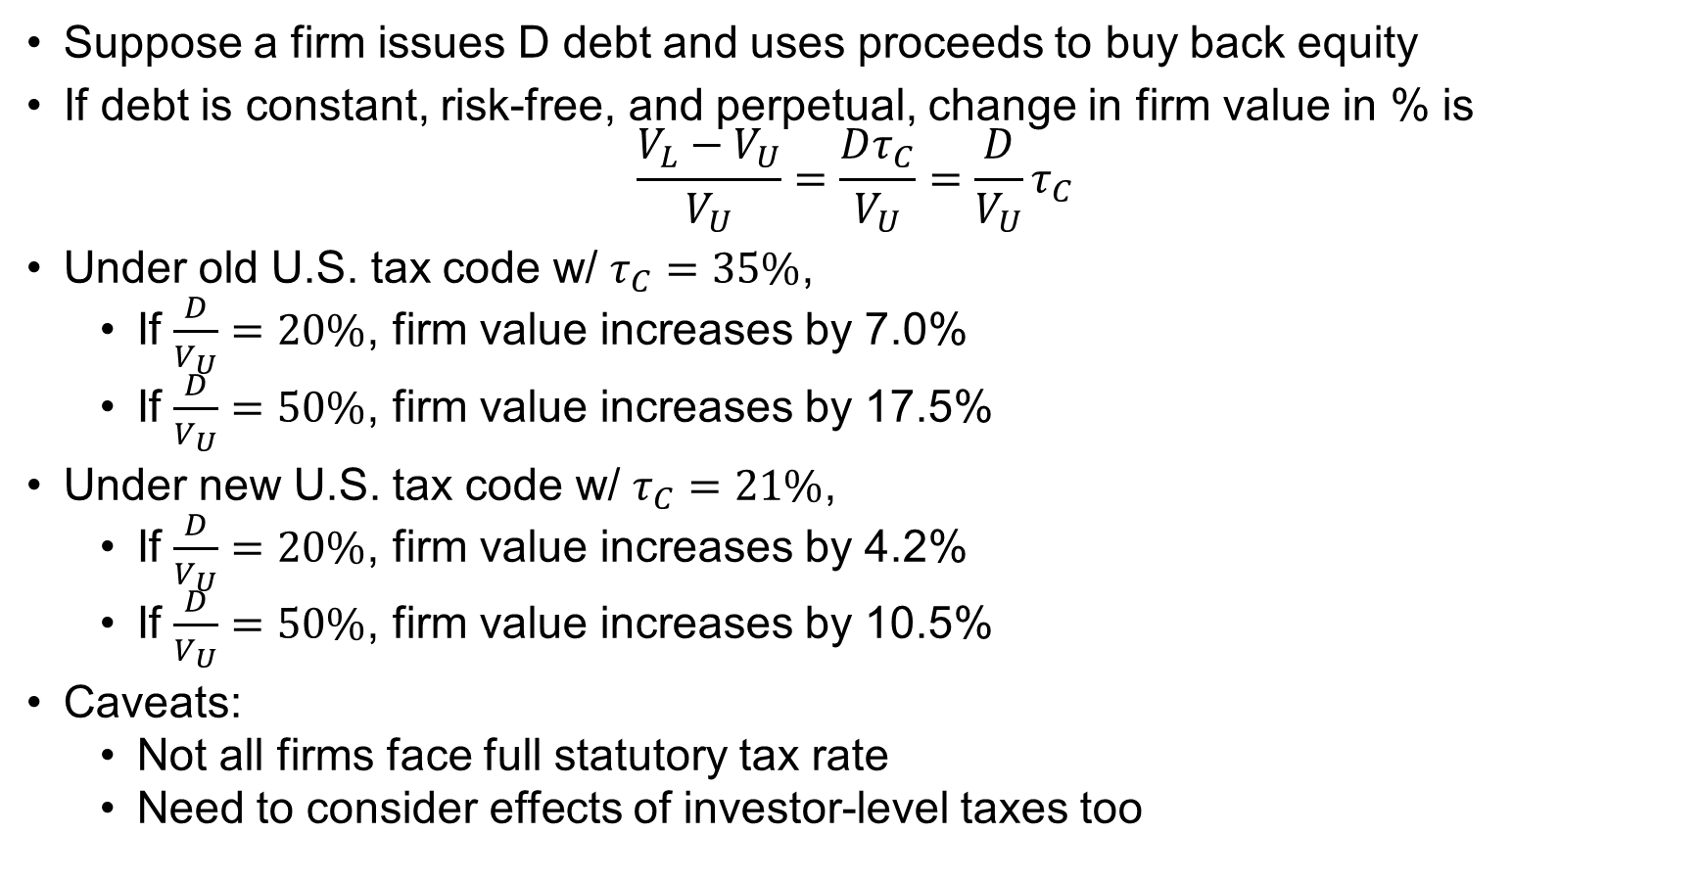
Value of debt tax shields
Suppose a firm issues D debt and uses proceeds to buy back equity
If debt is constant, risk-free, and perpetual, change in firm value in % is
$$\frac{V_{L}−V_{U}}{V_{U}}=\frac{Dτ_{C}}{V_{U}}=\frac{D}{V_{U}}τ_{C}$$
Under old U.S. tax code w/ $τ_{C}=35\%$,
If $\frac{D}{V_{U}}=20\%$, firm value increases by 7.0%
If $\frac{D}{V_{U}}=50\%$, firm value increases by 17.5%
Under new U.S. tax code w/ $τ_{C}=21\%$,
If $\frac{D}{V_{U}}=20\%$, firm value increases by 4.2%
If $\frac{D}{V_{U}}=50\%$, firm value increases by 10.5%
Caveats:
Not all firms face full statutory tax rate
Need to consider effects of investor-level taxes too

Slide 39
Who gets tax benefits from debt?
If debt issued at fair price (PV of future payments to creditor = amount borrowed), shareholders get all tax benefits from debt
All equity firm has $10M market value, announces that it will issue $2M of perpetual risk-free bonds and use proceeds to buy back equity
Corporate tax rate is 40%
Value of tax shield = 40% x $2M = $0.8M
If debt is issued at a fair price, equity will increase in value to $10.8M upon announcement of transaction
After transaction completed, shareholders will have
Equity worth $8.8M
$2M of cash

Slide 40
Debt and investor-level taxes
Investors care about after-tax cash flows → Investor-level taxes also matter for financing policy
Interest income received by creditors taxed at personal income tax rate
Dividends taxed at special dividend tax rate
Share repurchases: Gain (repurchase price minus “basis”) taxed at capital gains tax rate
Basis: generally price at which investor originally purchased a share
Generally, higher corporate, dividend, capital gains tax rates favor debt; higher interest income tax rate favors equity
Many institutional investors (e.g., pension funds) are tax exempt

Slide 41
Debt, taxes, and ???
Increasing debt increases tax shields
Why don’t firms financial w/ 100% debt?
Financial distress costs (including bankruptcy costs)

Slide 42
Tradeoff view of capital structure
Bankruptcy costs
Unlevered value
Tax shields
Debt*
Debt
$$Value=Unlevered value+TaxShields(Debt)−BRCosts(Debt)$$
$$TaxShields^{′}({Debt}^{∗})=BRCosts^{′}({Debt}^{∗})$$
$$(Marginal Benefit of Debt)=(Marginal Cost of Debt)$$

Slide 43
Firm vs. equity value
Generally focus on firm value when evaluating investment, financing decisions
How to square w/ objective of maximizing shareholder value?
If debt is issued at “fair” price, then maximizing firm & shareholder value generally equivalent
Exceptions for firms that already have debt outstanding:
May be able to transfer wealth from existing creditors to shareholders by issuing additional debt ← next few slides
Highly-leveraged firms may be able to increase equity value by making risky investments that reduce firm value (and therefore hurt creditors) ← next set of slides

Slide 44
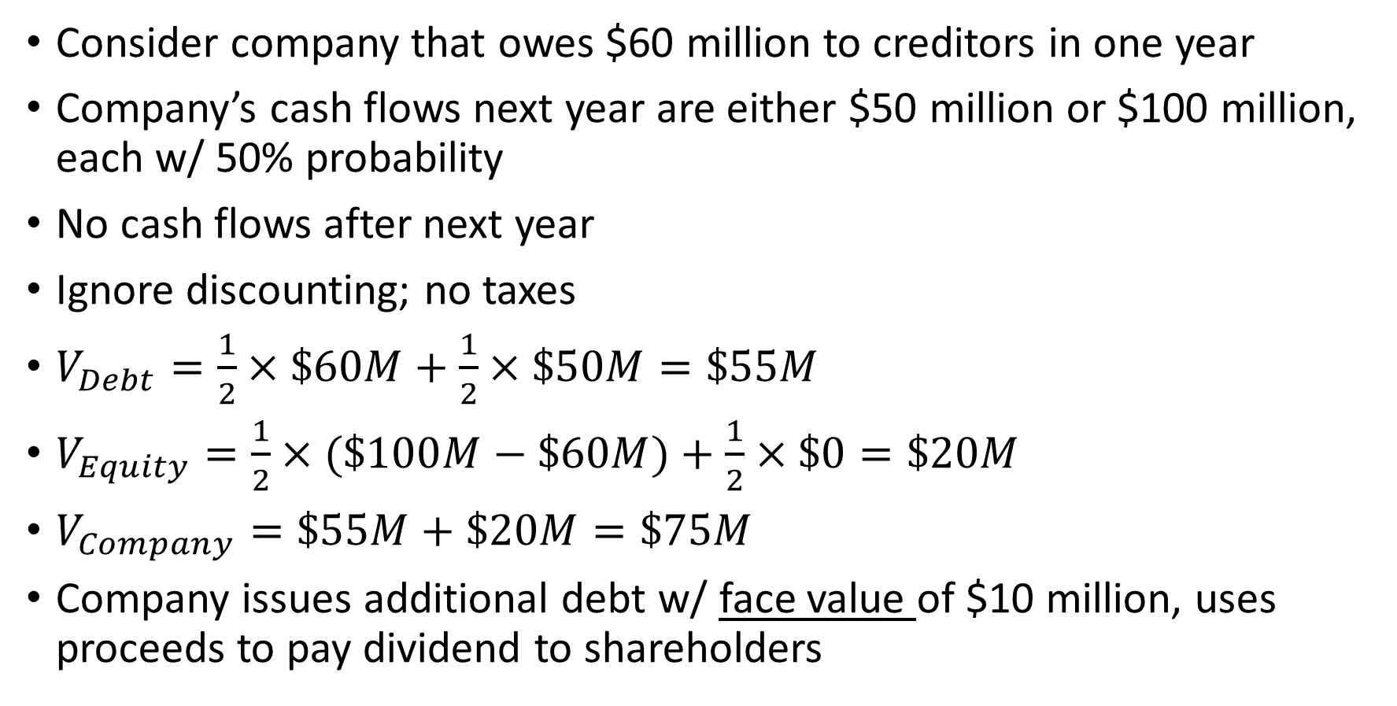
Transfer from existing creditors
Consider company that owes $60 million to creditors in one year
Company’s cash flows next year are either $50 million or $100 million, each w/ 50% probability
No cash flows after next year
Ignore discounting; no taxes
$V_{Debt}=\frac{1}{2}×\$60M+\frac{1}{2}×\$50M=\$55M$
$V_{Equity}=\frac{1}{2}×(\$100M−\$60M)+\frac{1}{2}×\$0=\$20M$
$V_{Company}=\$55M+\$20M=\$75M$
Company issues additional debt w/ face value of $10 million, uses proceeds to pay dividend to shareholders

Slide 45
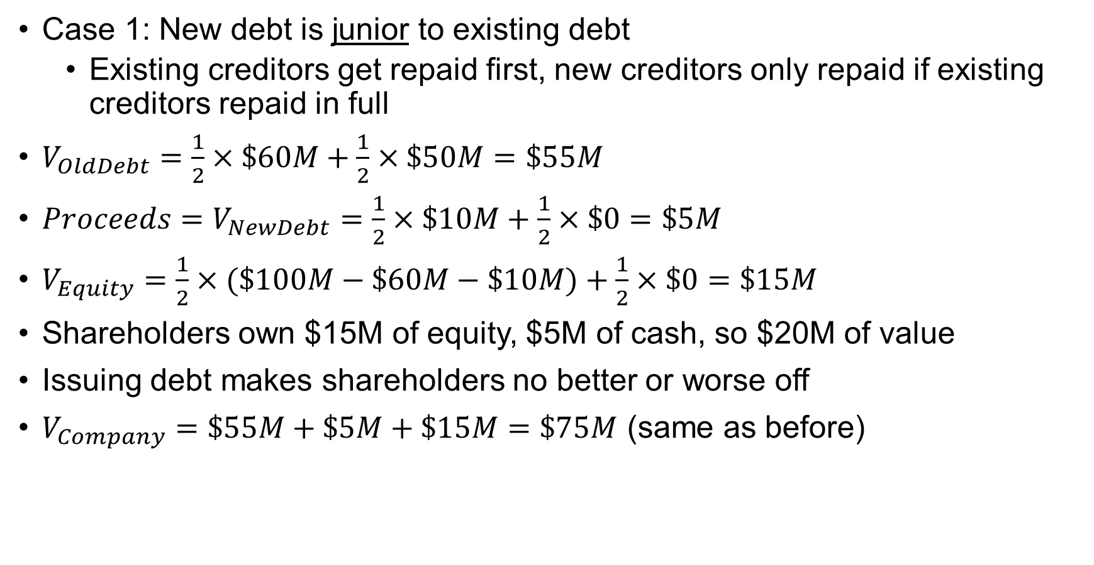
Transfer from existing creditors
Case 1: New debt is junior to existing debt
Existing creditors get repaid first, new creditors only repaid if existing creditors repaid in full
$V_{OldDebt}=\frac{1}{2}×\$60M+\frac{1}{2}×\$50M=\$55M$
${Proceeds=V}_{NewDebt}=\frac{1}{2}×\$10M+\frac{1}{2}×\$0=\$5M$
$V_{Equity}=\frac{1}{2}×(\$100M−\$60M−\$10M)+\frac{1}{2}×\$0=\$15M$
Shareholders own $15M of equity, $5M of cash, so $20M of value
Issuing debt makes shareholders no better or worse off
$V_{Company}=\$55M+\$5M+\$15M=\$75M$ (same as before)

Slide 46
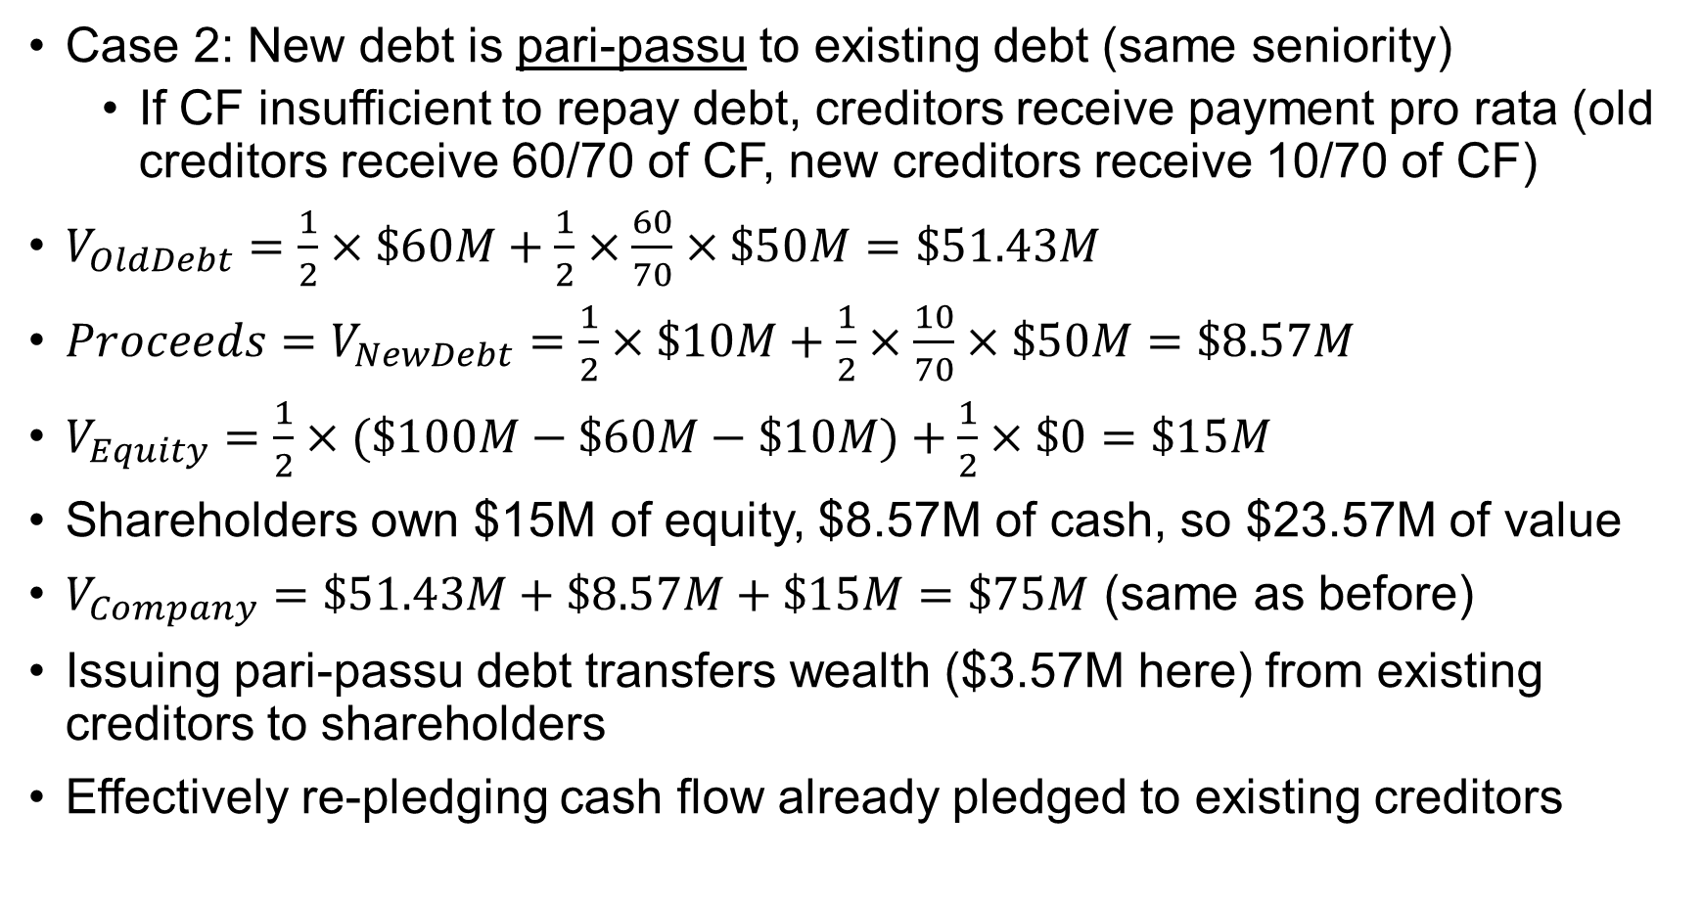
Transfer from existing creditors
Case 2: New debt is pari-passu to existing debt (same seniority)
If CF insufficient to repay debt, creditors receive payment pro rata (old creditors receive 60/70 of CF, new creditors receive 10/70 of CF)
$V_{OldDebt}=\frac{1}{2}×\$60M+\frac{1}{2}×\frac{60}{70}×\$50M=\$51.43M$
${Proceeds=V}_{NewDebt}=\frac{1}{2}×\$10M+\frac{1}{2}×\frac{10}{70}×\$50M=\$8.57M$
$V_{Equity}=\frac{1}{2}×(\$100M−\$60M−\$10M)+\frac{1}{2}×\$0=\$15M$
Shareholders own $15M of equity, $8.57M of cash, so $23.57M of value
$V_{Company}=\$51.43M+\$8.57M+\$15M=\$75M$ (same as before)
Issuing pari-passu debt transfers wealth ($3.57M here) from existing creditors to shareholders
Effectively re-pledging cash flow already pledged to existing creditors

Slide 47
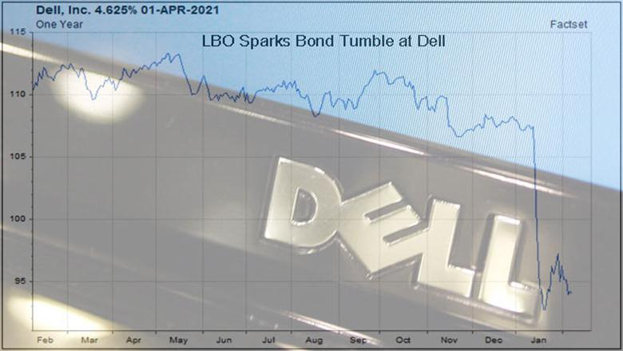
Dell leveraged buyout & bond prices

Slide 48
Protections for creditors
How would you protect yourself from future wealth transfers if you were a creditor?
Covenants restricting future debt issuance, dividend payments
Dividend payment even w/o further debt issuance makes existing debt riskier, reduces its market value
Transfers from creditors benefit shareholders. Why would shareholders ever agree to these restrictions?
Better creditor protections → lower interest rates
Tradeoff: Covenant on debt issuance may limit flexibility to issue debt to make positive-NPV investments

